Slide 1
The Dyakonov-Shur Instability of Viscous Electrons
Jack H. Farrell
Supervisors: Nicolas Grisouard & Thomas Scaffidi
21 August 2020

Slide 2
Outline
Setup (1): “Rectangular” [Mendl, Polini, Lucas, 2019]
Setup 2: “Corbino” [New Work]

Slide 3







Setup
$$L$$
$$E$$
$$e^{−}$$
$$n(x,t)$$
$$J\left(x,t\right)=n\left(x,t\right)v(x,t)$$
$$n\left(0,t\right)=n_{0}$$
$$J\left(L,t\right)=n_{0}v_{0}$$

Slide 4

Goals
Flow with these Dyakonov-Shur Boundary Conditions is theoretically unstable. [Dyakonov, Shur, 1993]
Growing modes have frequencies in the TeraHertz range (${10}^{12})$
“Dyakonov-Shur Instability”
What is the endpoint of the instability?
How do properties of the endpoint depend on the problem’s parameters?
  Parameters: $v_{0}, η, γ$
  Properties: Onset, Frequency, Amplitude

Slide 5




Equations
Viscosity
Momentum Relaxation
Viscosity
$$\frac{∂J}{∂t}+\frac{∂}{∂x}\left(\frac{J^{2}}{n}\right)+v_{s}^{2}\frac{∂n}{∂x}−\frac{η}{m}\frac{∂^{2}}{{∂x}^{2}}\left(\frac{J}{n}\right)=−n\frac{e}{m}E−γJ$$
$$γnv_{0}$$
Convection
Pressure
$$=γ(nv_{0}−J)$$
Momentum Relaxation
$$\frac{∂n}{∂t}+\frac{∂J}{∂x}=0$$

Slide 6





Numerical Methods
$$\frac{∂}{∂t}\left(\begin{aligned} \\ \\ \\ \\ \\ \\ \\ \\ \end{aligned}\right)$$
$$\frac{∂}{∂x}\left(\begin{aligned} \\ \\ \\ \\ \\ \\ \\ \\ \end{aligned}\right)$$
$$n$$ |  | $$J$$ |  | 0 |  | 0
 | $$+$$ |  | $$=$$ |  | $$+$$
$$J$$ |  | $$\frac{J^{2}}{n}+n$$ |  | $$\text{η}\frac{∂^{2}}{{∂x}^{2}}\frac{J}{n}$$ |  | $$γ\left(nv_{0}−J\right)$$
“Strang Splitting”
Conservation Law Part
“Isothermal Gas Dynamics”
Finite Volume Method
Explicit Finite Differences quotient

Slide 7
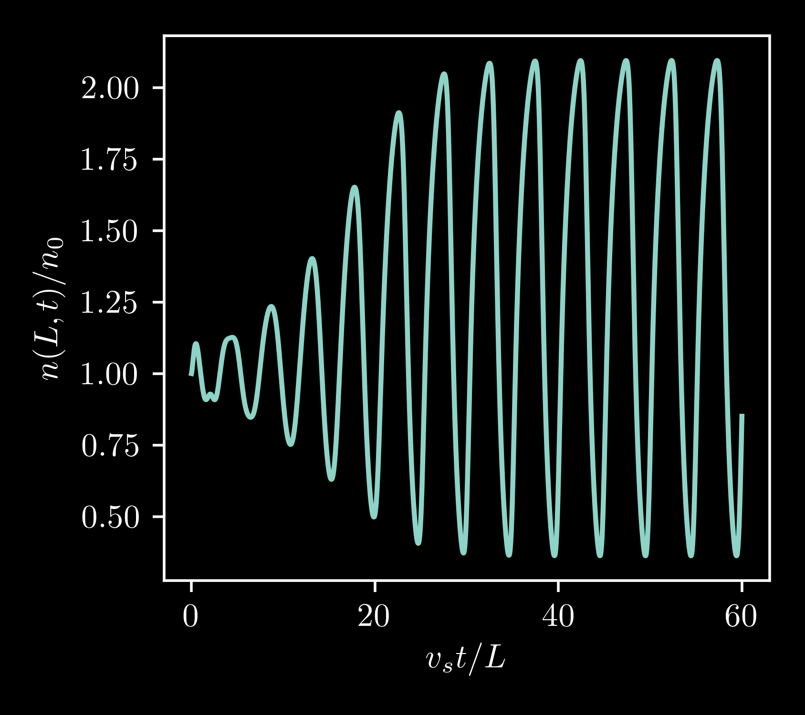
Result: The endpoint of the instability is a coherent nonlinear oscillator

Slide 8
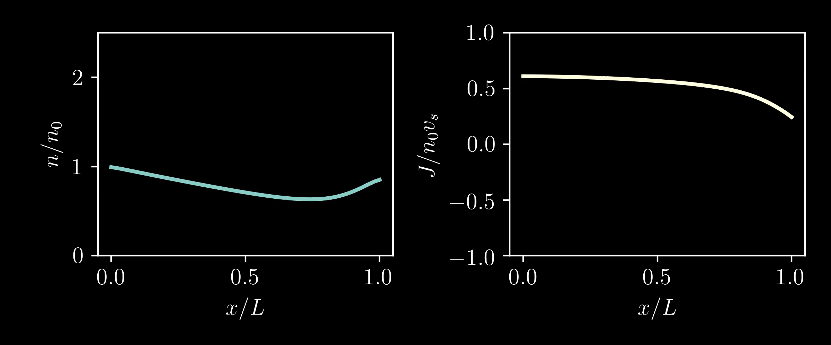
Result: The endpoint of the instability is a coherent nonlinear oscillator

Slide 9
Outline
Setup (1): “Rectangular” [Mendl, Polini, Lucas, 2019]
Setup 2: “Corbino” [New Work]

Slide 10










Corbino Geometry
$$b$$
$$E$$
New Parameter:
$$n\left(r=a\right)=n_{0}$$
$$J\left(r=b\right)=n_{0}v_{b}$$
$$L/a$$
$$a$$
$$L$$
$$e^{−}$$
$$n(r,t)$$
$$J\left(r,t\right)$$

Slide 11


$$\frac{∂J}{∂t}+ \frac{1}{r}\frac{∂}{∂r}\left(r\frac{J^{2}}{n}\right)+v_{s}^{2}\frac{∂n}{∂r}−\text{η}\left(\frac{1}{r}\frac{∂}{∂r}\left(r\frac{∂}{∂r}\left(\frac{J}{n}\right)\right)−\frac{1}{r^{2}}\frac{J}{n}\right)= γ\left(\frac{{nv}_{b}b}{r} −J\right)$$
Convection
Pressure
Viscous Diffusion
Momentum Relaxation
$$\frac{∂n}{∂t}+ \frac{1}{r}\frac{∂}{∂r}\left(rJ\right)=0$$

Slide 12





Numerical Methods
$$\frac{∂}{∂t}\left(\begin{aligned} \\ \\ \\ \\ \\ \\ \\ \\ \end{aligned}\right)$$
$$\frac{∂}{∂r}\left(\begin{aligned} \\ \\ \\ \\ \\ \\ \\ \\ \end{aligned}\right)$$
$$n$$ |  | $$J$$ |  |  |  |  |  | $$−\frac{1}{r}\left(J\right)$$
 | $$+$$ |  | $$=$$ |  | $$+$$ |  | $$+$$
$$J$$ |  | $$\frac{J^{2}}{n}+n$$ |  | $$\text{η}\left(\frac{∂^{2}}{{∂r}^{2}}+\frac{1}{r}\frac{∂}{∂r}− \frac{1}{r^{2}}\right)\frac{J}{n}$$ |  | $$γ\left(\frac{{nv}_{0}b}{r} −J\right)$$ |  | $$−\frac{1}{r}\left(\frac{J^{2}}{n}\right)$$
Conservation Law Part
“Isothermal Gas Dynamics”
Finite Volume Method
Explicit Finite Differences quotient
“Strang Splitting”

Slide 13
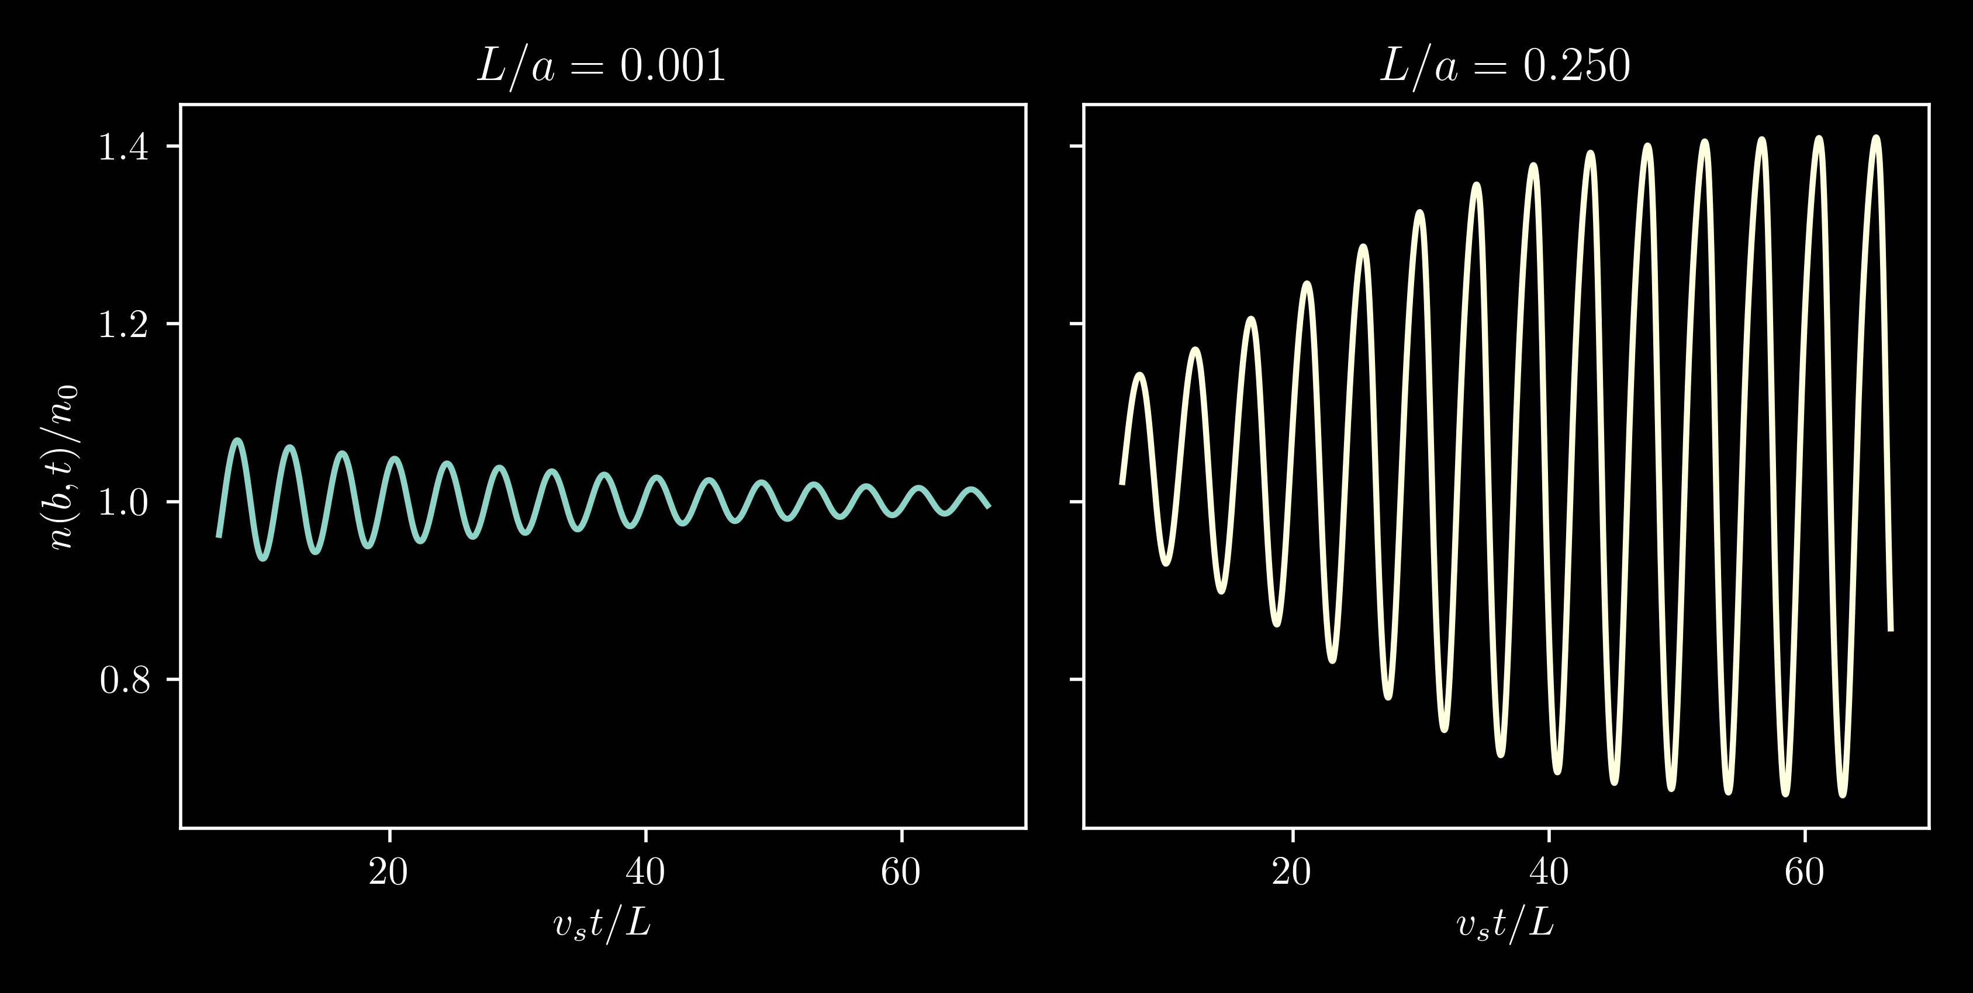
Corbino Geometry Favours the Instability

Slide 14
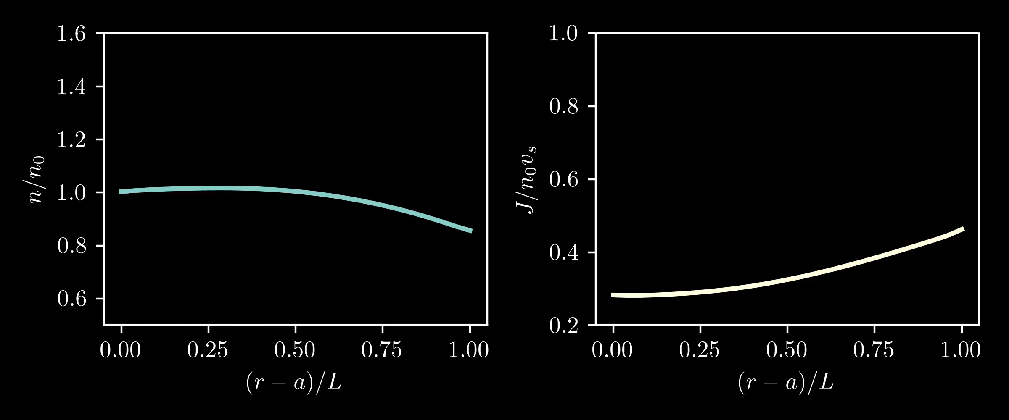
Corbino Geometry Favours the Instability

Slide 15
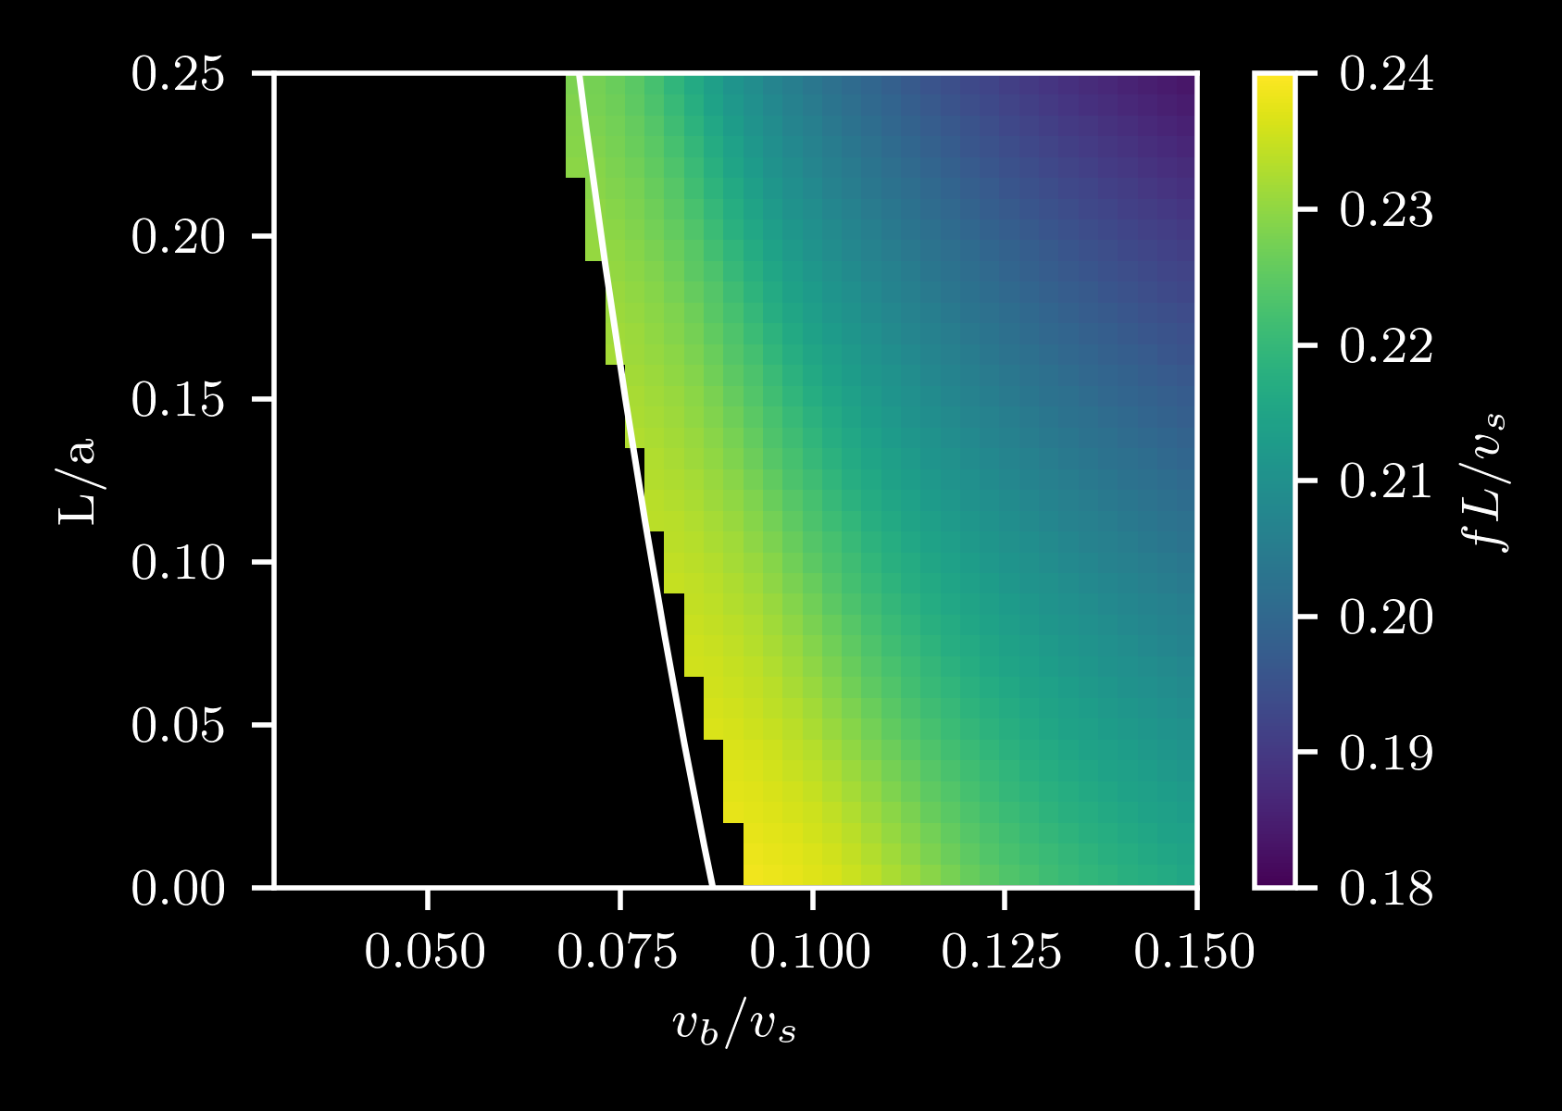
Corbino Geometry Favours the Instability

Slide 16
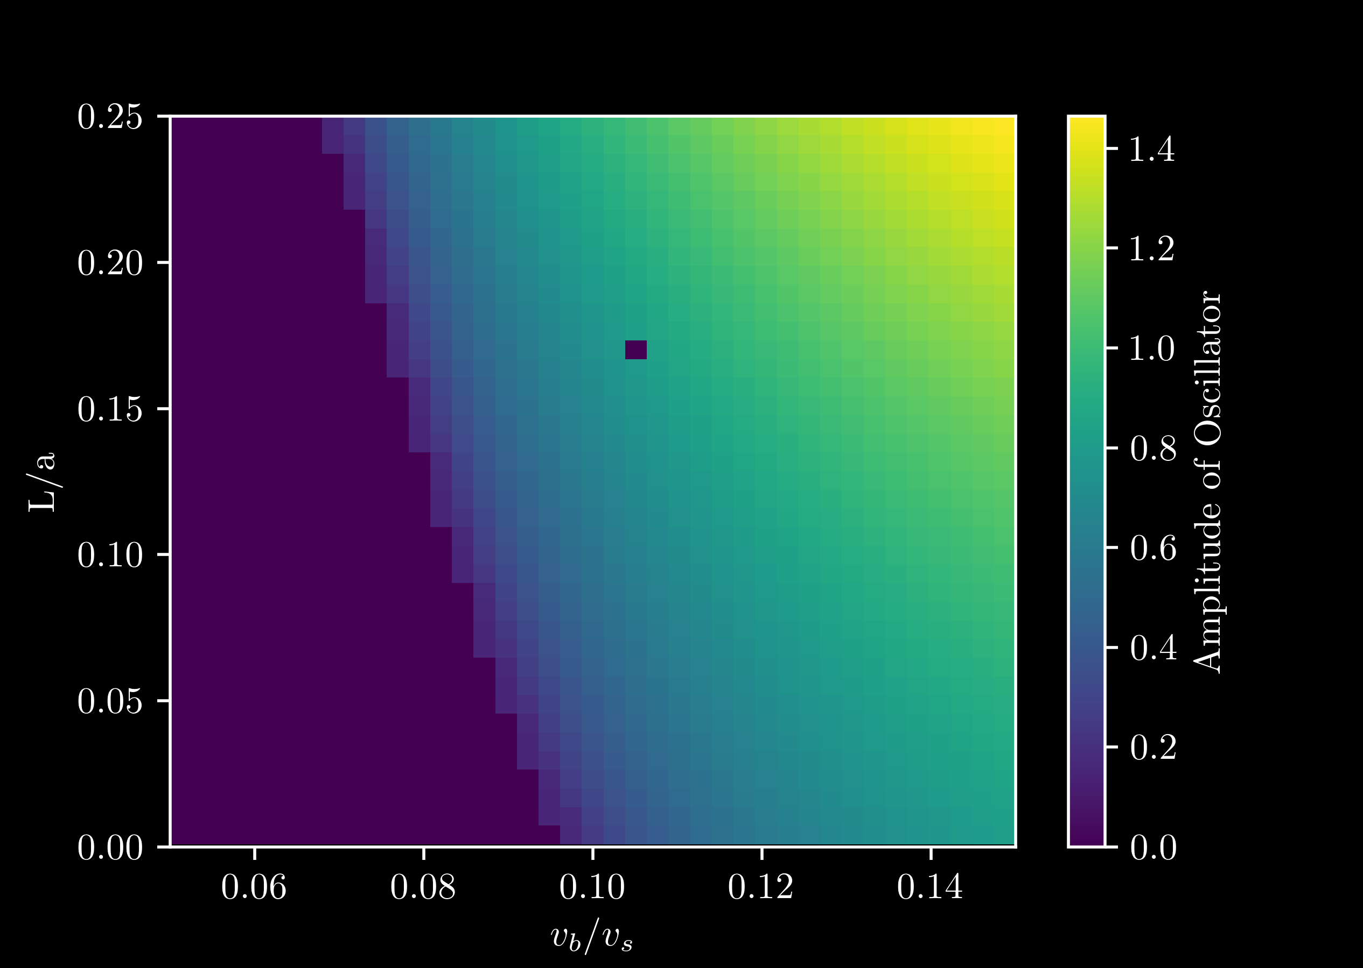
Corbino Geometry Favours the Instability

Slide 17
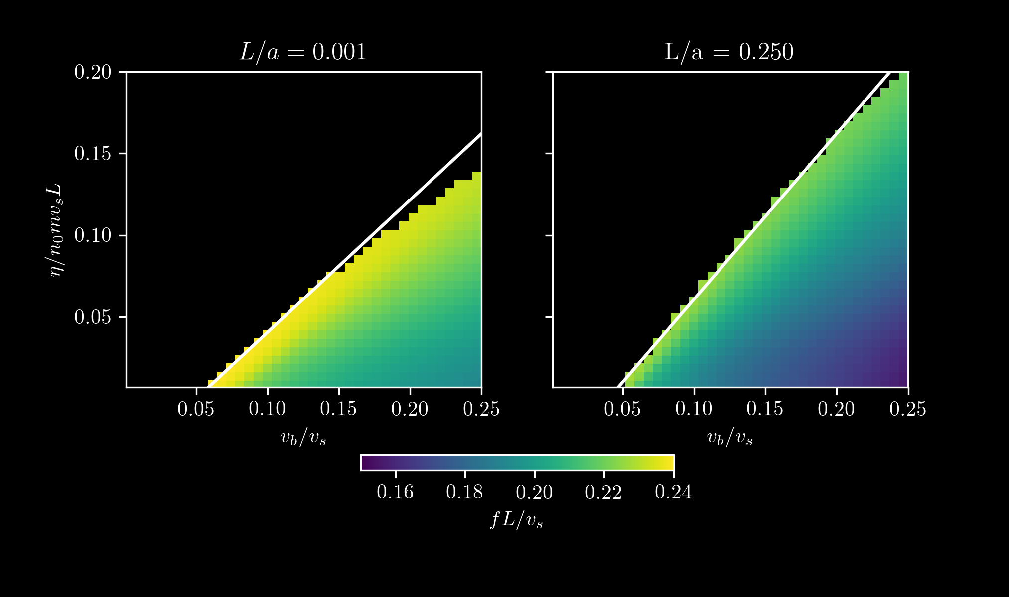
Corbino Geometry Favours the Instability

Slide 18
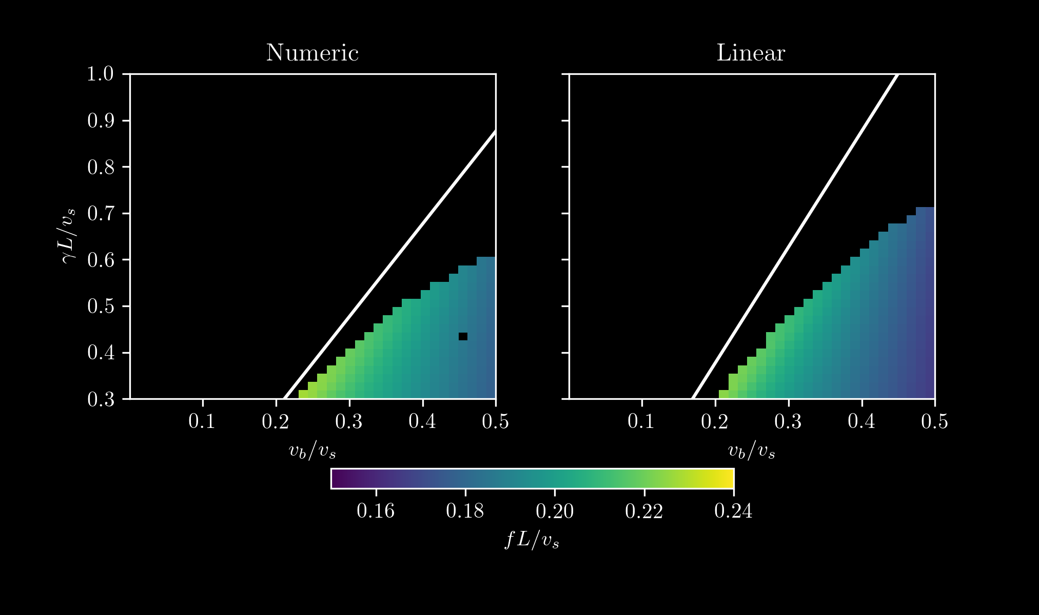
Corbino Geometry Favours the Instability

Slide 19

Summary
Flow with these Dyakonov-Shur Boundary Conditions is theoretically unstable. [Dyakonov, Shur, 1993]
What is the endpoint of the instability?
How do properties of the endpoint depend on the problem’s parameters?
  Parameters: $v_{0}, η, γ, L/a$
  Properties: Onset, Frequency, Amplitude

Slide 20
Other Ideas?
Other Boundary Conditions?
Magnetic Field?
More hydrodynamic instabilities?

Slide 21
Thank you!
Nico and Thomas
Other undergraduates
Nico’s Group!

